Slide 1
Covid Surge Plan 2023
Kathi Devine
Karen Gruber
Franziska Jovin
Raquel Nahra

Slide 2
Current NJ Covid Landscape
NJ population vaccination status – bivalent booster
  18 % aged 5 and older
  35 % of 65 and older
Current circulating strain is more rapidly transmissible and evades immune system of vaccinated or previously infected individuals
Ambulatory Treatment options with impact on preventing hospitalization
  Remdesivir (often refused as it requires 3 days of coming to an infusion center)
  Paxlovid
No MAB commercially available to treat the current circulating variant

Slide 3
Current NJ Covid Landscape
Current Community transmission is high
We are expecting as the XBB1.5 variant increases to see an increase in admitted cases.
Different clinical environment from prior surge plans:
  The state has no plans to mandate cancelling of elective surgical cases
  The state has no plans to engage on a total or partial lock down
  The institution has had persistent increased census
The surge plan is drafted to optimize operations under the current circumstances allowing us to function as a tertiary care center

Slide 4
Current NJ COVID landscape
Determination on what surge level the hospital will operate depends on:
  Total Hospital census or ED physical room capacity
  AND
  Community transmission metric
This is only applicable while the emergency order in place

Slide 5
Previous surge plan
 | COVID census | Units occupied | Elective procedures
Level 0 | No COVID |  | No cancelation
Level 1 | COVID Med Surg <10 patients COVID INCU +ICU <34 patients | CDU/Viner ICU/CCAA | No cancelation
Level 2 | COVID Med Surg <10 patients COVID INCU +ICU <34 patients | CDU/Viner ICU/CCAA /Kellemen S Med surge NPR | No cancellation
Level 3 | COVID Med Surg 17-32 patients COVID INCU +ICU 30-50 patients | CDU/Viner ICU /CCAA/Kellemen S Med surge NPR /K3 /Field hospital | Surgical governance
Level 4 Dedicated unit reached when Kelemen S or CCU is a COVID dedicated unit | COVID Med Surg 33-63 patients COVID INCU+ICU 47-62 patients | CDU/ Viner ICU / Kellemen S Med surge NPR / K3 / CCAA/ Field Hospital Overflow | Surgical governance
Level 5 reached when a second Kelemen S is a COVID dedicated unit P10 becomes a zoned unit | COVID Med Surg 64-96 patients COVID INCU+ICU 47-62 patients | CDU+ Kelemen South (2 units) COVID + 9Negative Pressure Rooms (NPR)+Kelemen 3 CCU COVID+Viner ICU + CCAA +Kelemen 3 Field Hospital Overflow | Surgical governance
Level 6 reached when Kelemen 9 S is a COVID dedicated unit | COVID Med Surg 101-129 patients COVID INCU+ICU 59-92 patients | CDU+ Kelemen South10,8,9COVID + +Kelemen 3 CCU COVID+Viner ICU + CCAA +Kelemen 3 +P10 ICU Field Hospital Non COVID ICU created in PACU | Surgical Governance
Level 7 ICU patients in PACU or other non inpatient care areas | COVID Med Surg >129 patients COVID INCU+ICU >89 patients | As above and over flow units including non patient care area, PIMU, cath , psychiatry | Surgical Governance

Slide 6
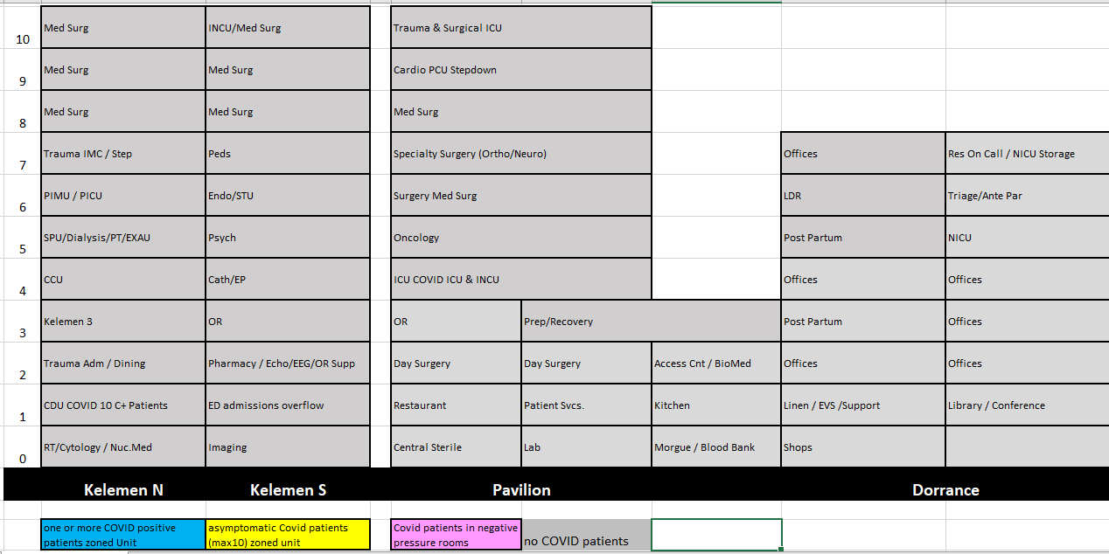
Surge Plan Level 0
Census at 80-100%
and
Community Transmission Not High

Slide 7
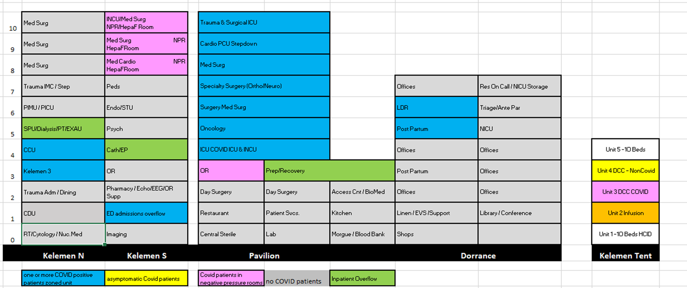
Surge Level 1
Census at 80-100%
or ED physical rooms at 98% or more
And
Community Transmission High

Slide 8
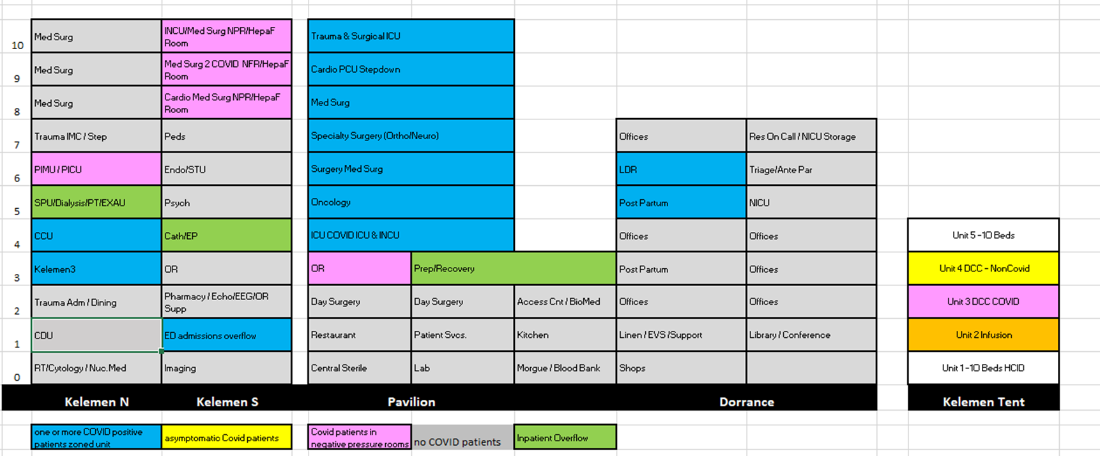
Surge Level 2
Census at 100% at least 2 days over a week period or
ED physical rooms at 98 % capacity at least 2 days
over a week period
And
Community Transmission level High

Slide 9
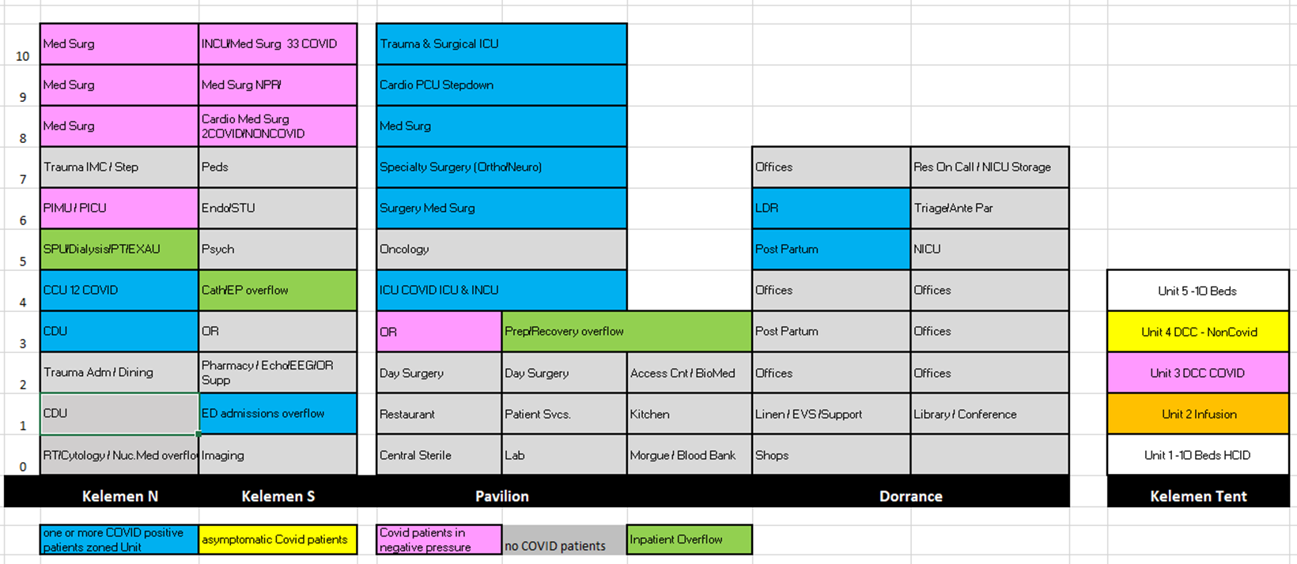
Surge Level 3
Census at >120 % for
at least 2 days over a week period
or ED at 98 % capacity for
at least 2 days over a week period
And
Community Transmission High

Slide 10
PIMU Utilization
PRO
CON
Additional available telemetry space
Underutilization of the space in absence of a pediatric volume surge
Availability of negative pressure rooms
Other available spaces are maxed out (So4/PACU)
Allows for delay in cancellation of surgeries
Proximity to pediatric unit
Need to ensure security of pediatric patients in PICU – mitigated by security presence
Adult patient population housed on PIMU disruptive to PICU patients and visitors
24/7 security officer resource
Ongoing need to cross between units as resources/rooms are shared between PIMU/PICU (staff bathroom, soiled utility)

Slide 11
PIMU Guidelines
Visitors- allowed once doors are secured
Safety Risk assessment of the Unit
Security presence at all times while housing adults in PIMU.
Flex unit (can be converted to a pediatric unit if pediatrics numbers rise)

Slide 12
Safety risk assessment
All doors from PIMU to PICU are secured with Punch lock
Finance team to be alerted of change
Access to play room (currently not being used to pediatric patients/child life staff)
PIMU staff educated on all access code on PICU side
Ensure criteria for admission to PIMU is developed (avoiding disruptive, behavioral, safety observations etc)
Adult patient care supplies need to be added and consistent to par level needs
Communication plan- daily huddle to alert ancillary services and operators regarding the change, weekly IMT update.
Broader communication to Team members regarding new surge plan.

Slide 13
Appendix

Slide 14
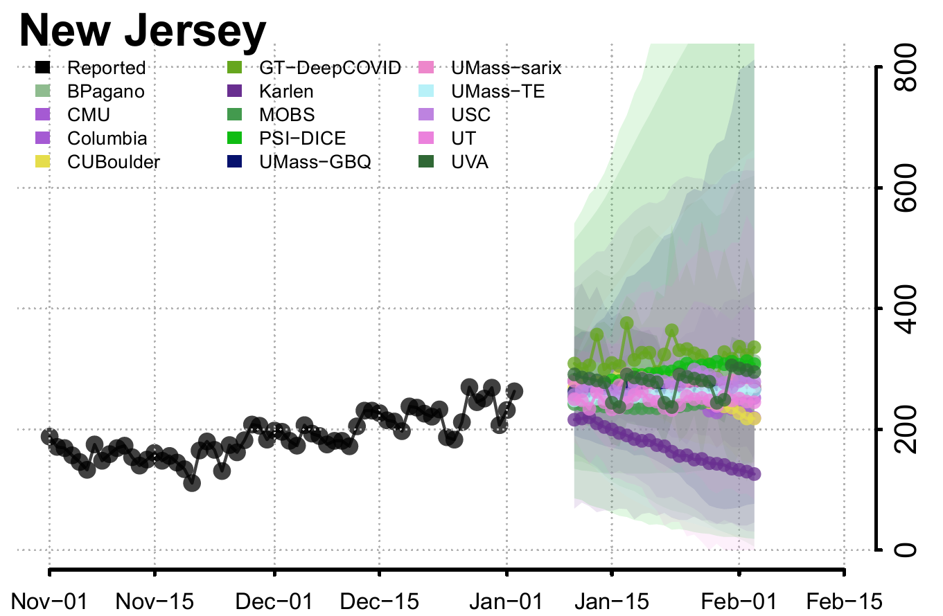
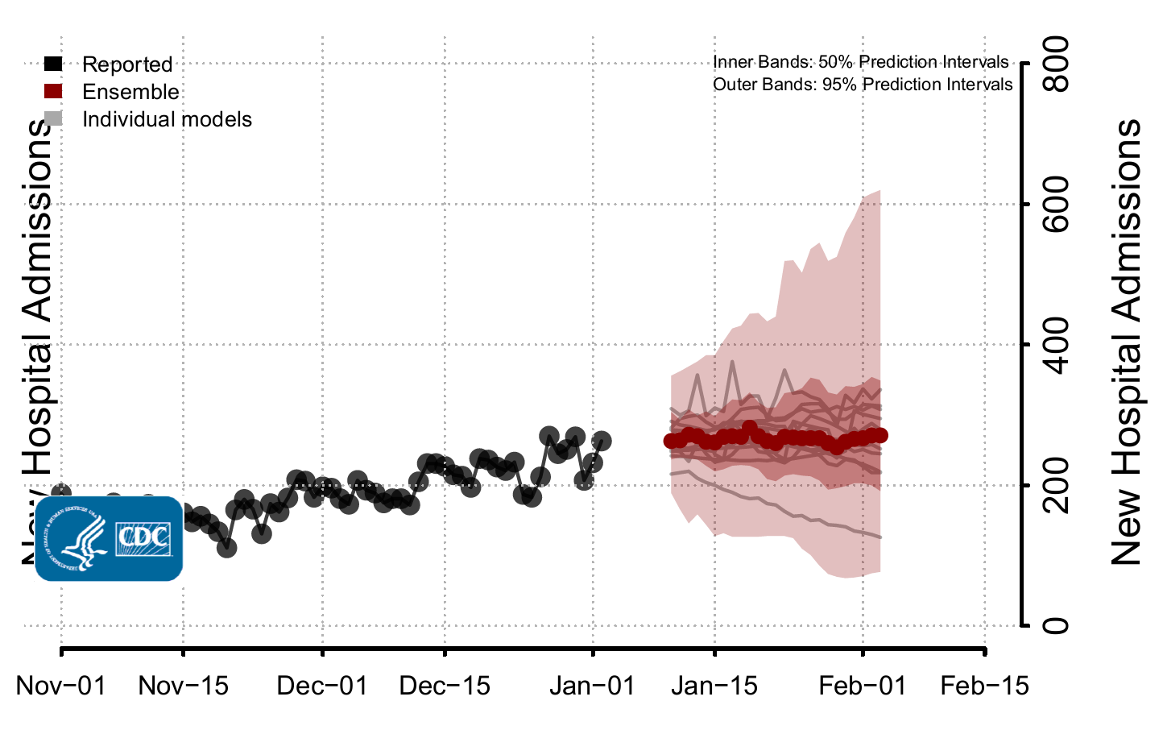
Prediction Models: Ensemble Forecast
Ensemble forecasts combine diverse independent team forecasts into one forecast.
While they have been among the most reliable forecasts in performance over time,
even the ensemble forecasts have not reliably predicted rapid changes in the trends of reported cases, hospitalizations, and deaths.
They should not be relied upon for making decisions about the possibility or timing of rapid changes in trends

Slide 15
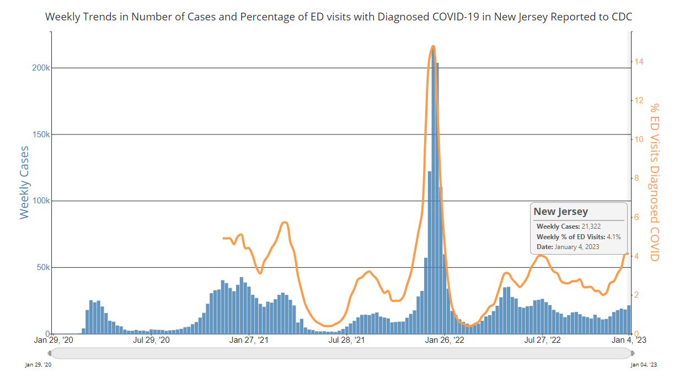
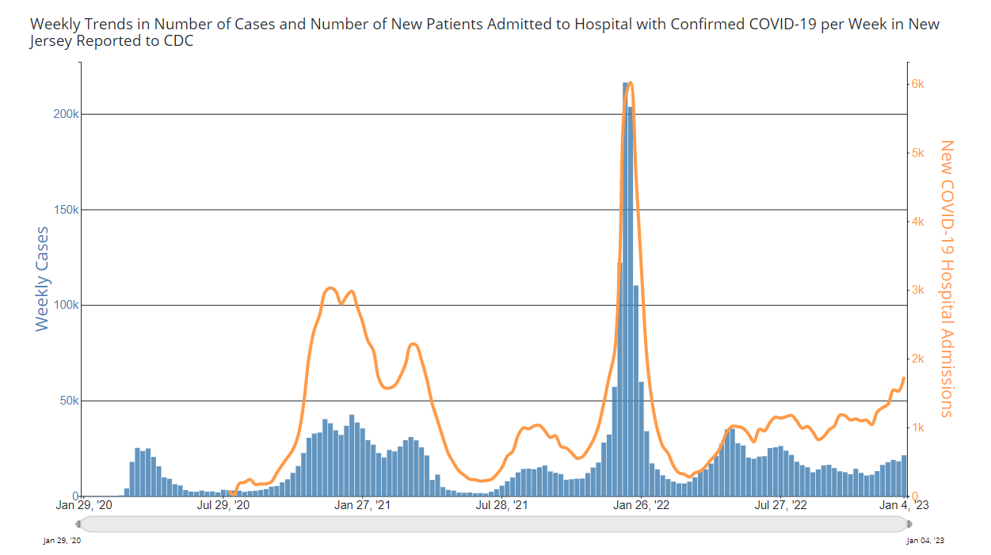
Observed COVID-19 cases In NJ
Data obtained early January can be biased by under reporting due to the holidays.
Source: https://covid.cdc.gov/covid-data-tracker/#trends_weeklycases_newhospitaladmissions_34

Slide 16
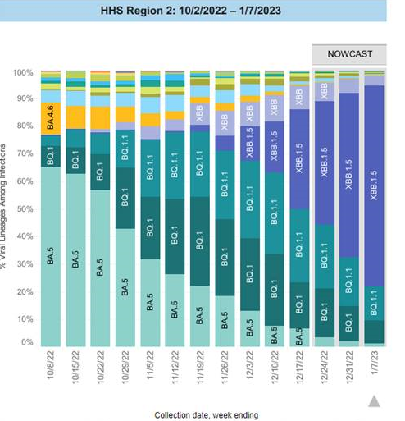
NJ variant data
New circulating variant affecting mostly New Jersey and NY.
Our region has around 72 % of the circulating variant being XBB1.5
Cooper sequencing data of specimens dated 12/22 showed around 21% XBB1.
Cooper lab provide real time sequencing information can be used to estimate the increase in cases ( symptomatic or asymptomatic). Software update is expected to provide us with more granular information

Slide 17
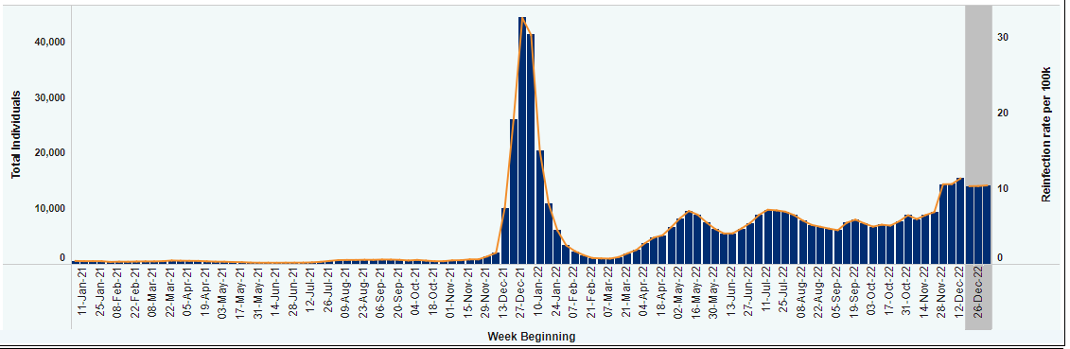
Reinfection and Circulating Variants
Impact of XBB1.5 on reinfection
SARS-CoV-2 collected between December 18 -- December 31, 2022 from New York that are sequenced and
uploaded into GISAID, 98.2% were the Omicron variant.
During this time period:
6.1% of all sequences were lineage BA.2,
0.0% were BA.4,
5.6% were BA.5,
10.6% were BQ.1,
16.4% were BQ.1.1,
7.6% were XBB
51.9% were XBB.1.5
Emerging at a time when both COVID-19 and flu cases are high, early data indicate that XBB.1.5 is able to spread more rapidly than other currently circulating variants

Slide 18
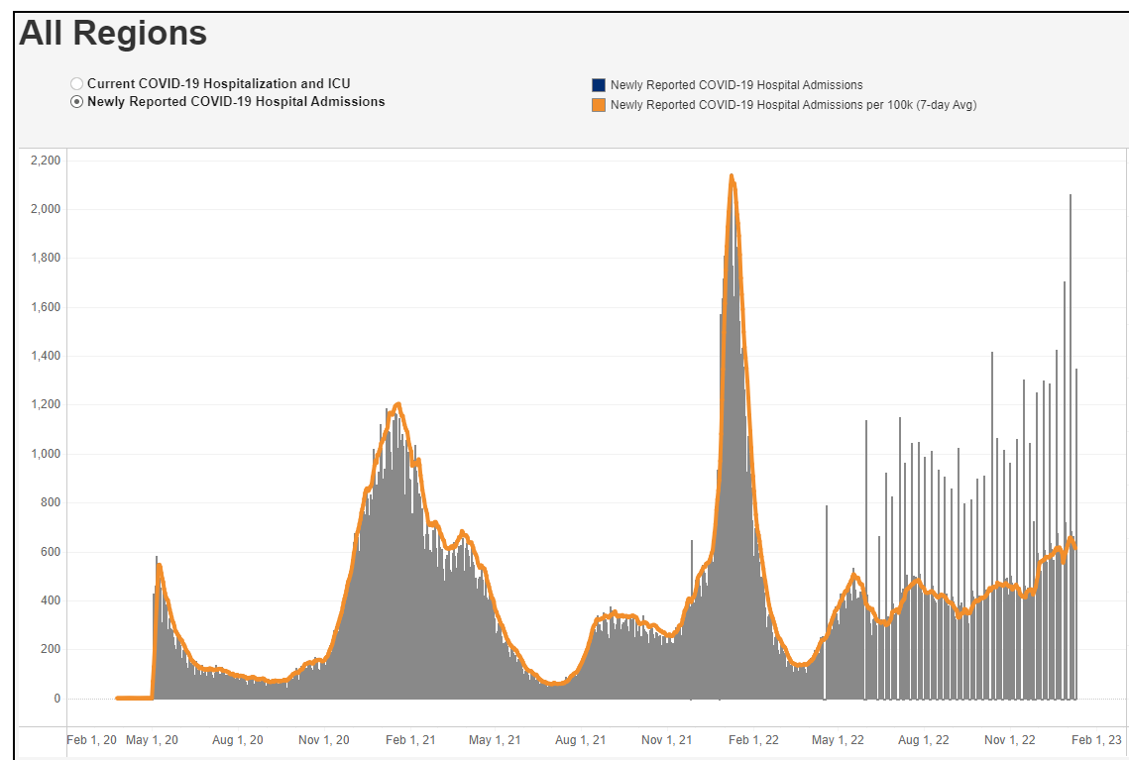
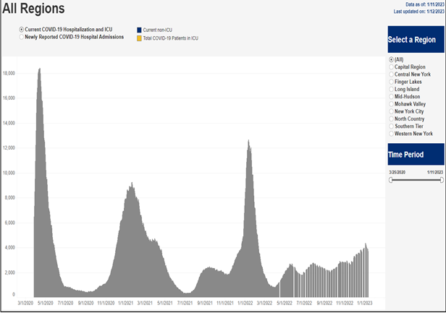
New York Hospitalization data and Circulating Variants
SARS-CoV-2 collected between December 18 -- December 31, 2022 from New York that are sequenced and
uploaded into GISAID, 98.2% were the Omicron variant.
During this time period:
6.1% of all sequences were lineage BA.2,
0.0% were BA.4,
5.6% were BA.5,
10.6% were BQ.1,
16.4% were BQ.1.1,
7.6% were XBB
51.9% were XBB.1.5
https://coronavirus.health.ny.gov/daily-hospitalization-summary

Slide 19
New York State Data
State of NY is unique as it provides granular variant data to the state
Understanding impact of XBB1.5 on NY hospitalization helps to inform some of our decision making given proximity of states and population crossover over state lines

