Slide 1


Cooper Norcross Health
Mission
To serve, to heal, to educate
Vision
We will be the best place to be a patient, the best place to work, and the best place to learn and practice medicine.

Slide 2


Cooper Norcross Health
Camden Main Campus
  663-bed academic tertiary care Cooper Norcross University Hospital
  Only Level I Trauma Center in South Jersey
  Cooper Medical School of Rowan University
  MD Anderson Cancer Center at Cooper
  Children’s Hospital at Cooper Norcross Health
Cape Main Campus
  229-bed Cooper Norcross University Hospital Cape Regional
  Claire C. Brodesser Surgery Center
  Cancer Center

Slide 3
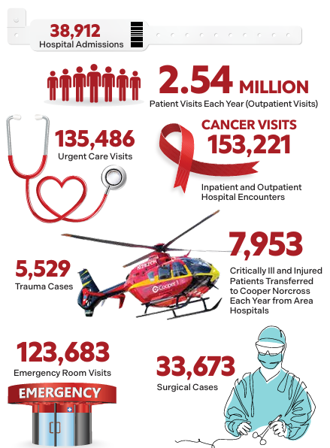
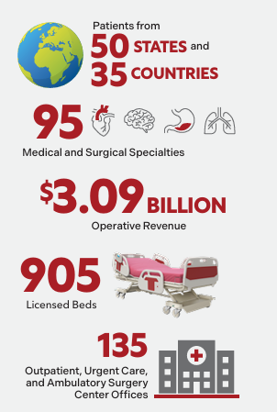
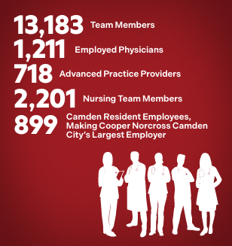
2026 Cooper Norcross Health Fast Facts
Statistics based on 2025 combined data for entire health system.

Slide 4
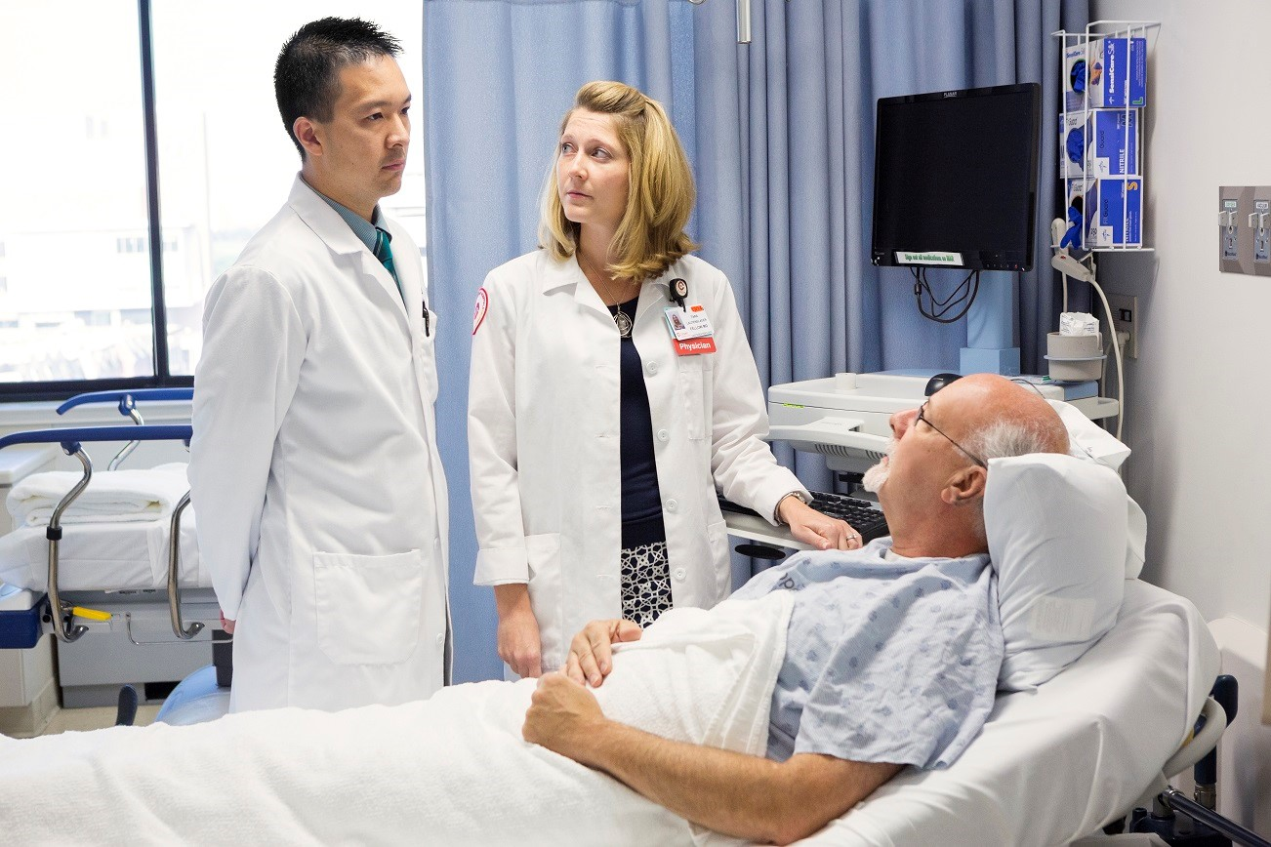
Institutes and Centers
    Adult Health Institute
    Bone and Joint Institute
    Heart Institute/Cooper and Inspira Cardiac Care
    MD Anderson Cancer Center at Cooper
    Neurological Institute/ Cooper and Inspira Neuroscience
    Surgical Services Institute
    Women’s and Children’s Institute
    Urban Health Institute
    Center for Hospital Medicine
    Center for Critical Care Services
    Center for Urgent and Emergent Services
    Center for Trauma Services
    Center for Population Health

Slide 5
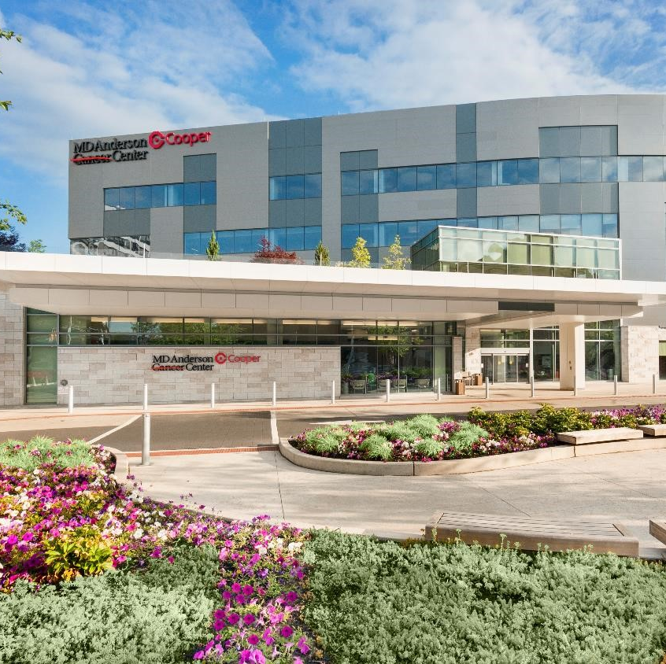
MD Anderson Cancer Center at Cooper
South Jersey’s leading cancer program – locations across the region
A team approach to cancer care
Advanced diagnostic and treatment technologies
Cancer clinical trials and supportive care services

Slide 6
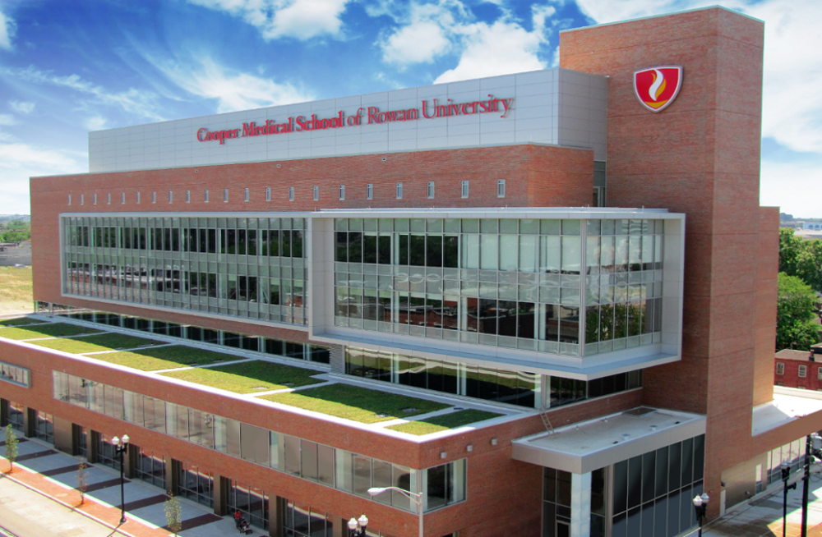
Cooper Medical School of Rowan University
Opened 2012
First class graduated in May 2016
Cooper Norcross Health physician faculty
50+ residency and fellowship programs

Slide 7
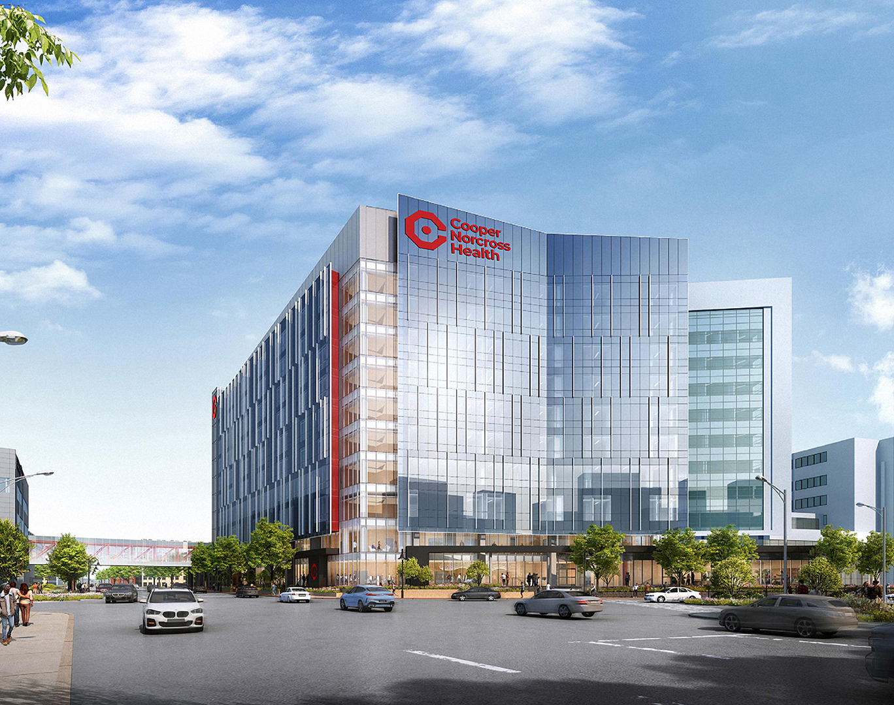
Project Imagine
10-year, $3 billion Camden Campus expansion
First patient tower opens in 2028

