Slide 1

Cooper University Health Care
Mission
To Serve, To Heal, To Educate
Vision
We will be the best place to be a patient, the best place to work, and the best place to learn and practice medicine.

Slide 2

Cooper University Health Care
Camden Main Campus
663-bed academic tertiary care hospital
Only Level I Trauma Center in South Jersey
Cooper Medical School of Rowan University
MD Anderson Cancer Center at Cooper
Children’s Regional Hospital
Cape Main Campus
242-bed Cooper University Hospital Cape Regional
Claire C. Brodesser Surgery Center
Cancer Center

Slide 3
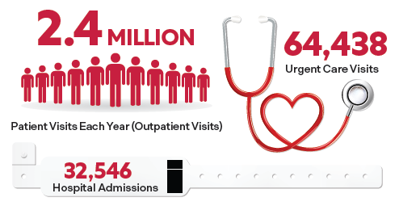
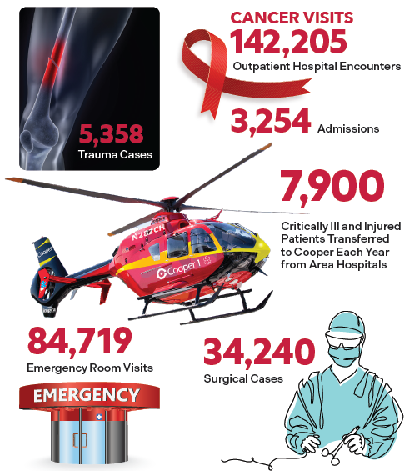
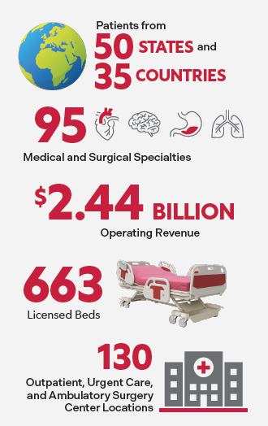
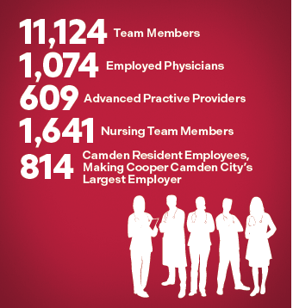
Cooper @ Camden Fast Facts 2024

Slide 4
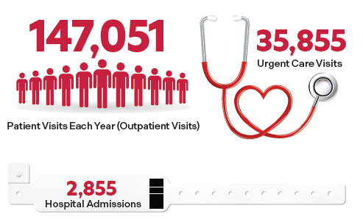
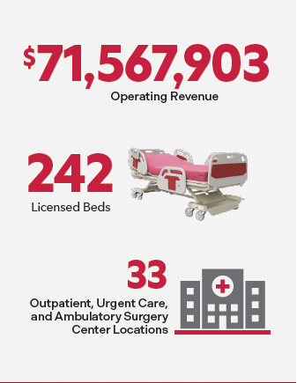
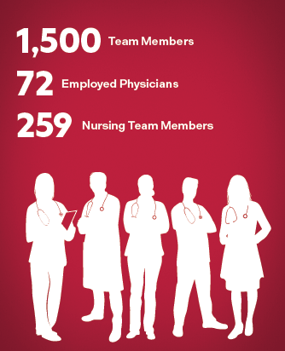
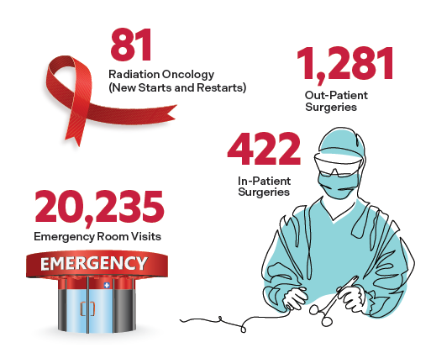
Cooper @ Cape Fast Facts 2024

Slide 5
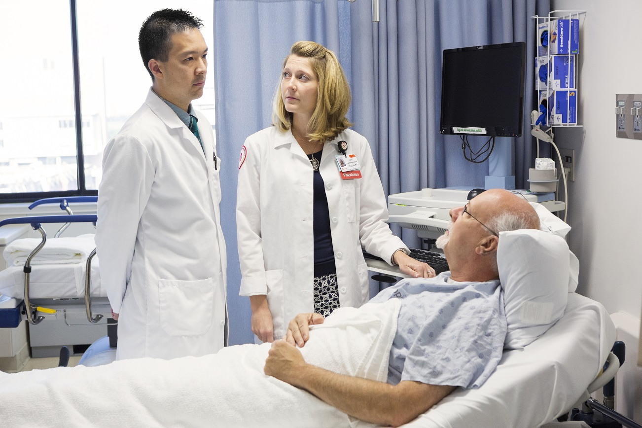
Institutes & Centers
Neurologic Institute
Bone and Joint Institute
MD Anderson Cancer Center at Cooper
Heart Institute/ Cardiac Partners
Surgical Services Institute
Adult Health Institute
Women’s and Children’s Institute
Urban Health Institute
Center for Hospital Medicine
Center for Critical Care Services
Center for Urgent and Emergent Services
Center for Trauma Services
Center for Population Health

Slide 6
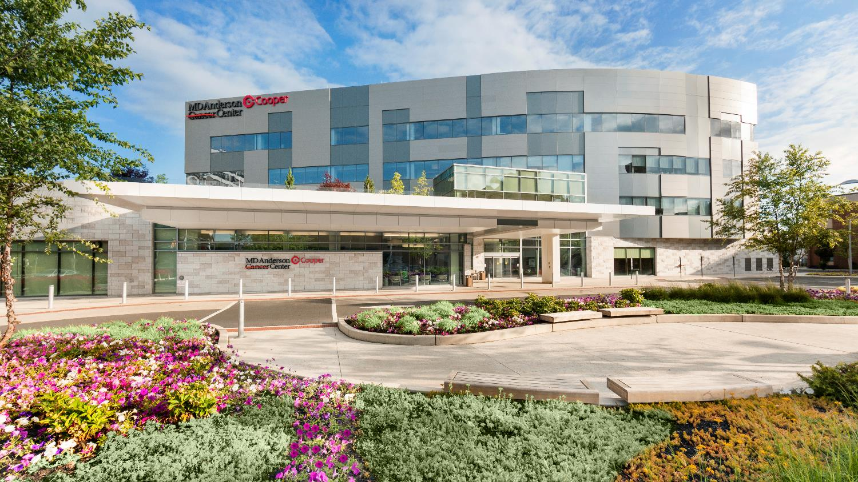
MD Anderson Cancer Center at Cooper
South Jersey’s leading cancer program – locations across the region
A team approach to cancer care
Advanced diagnostic and treatment technologies
Cancer clinical trials and supportive care services

Slide 7
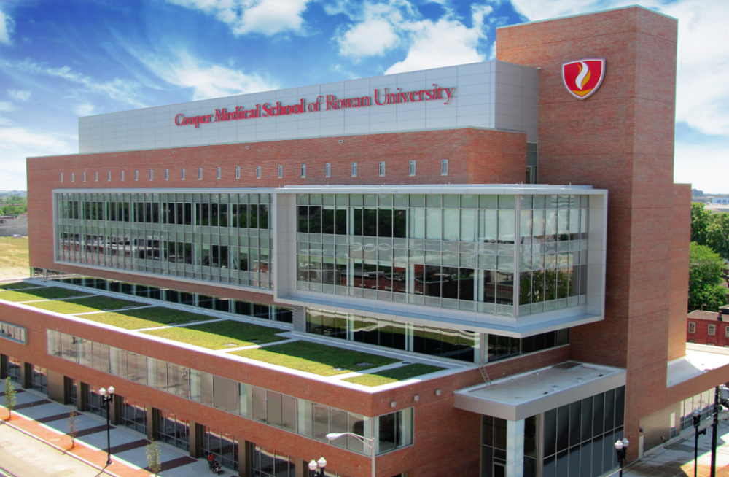
Opened 2012
First class graduated in May 2016
Faculty Cooper Physicians

